Slide 1

Determination of TNO detection efficiency using Machine Learning
Project realized by Vincent FORIEL
Supervised by Jean-Marc PETIT
23/06/2022
Master CompuPhys
Promotion 2021 - 2023

Slide 2
Contents
Context
Data processing
First steps in Machine Learning
Scaling the data set
K-fold cross-validation & genetic algorithm
Fresh news
Conclusion

Slide 3
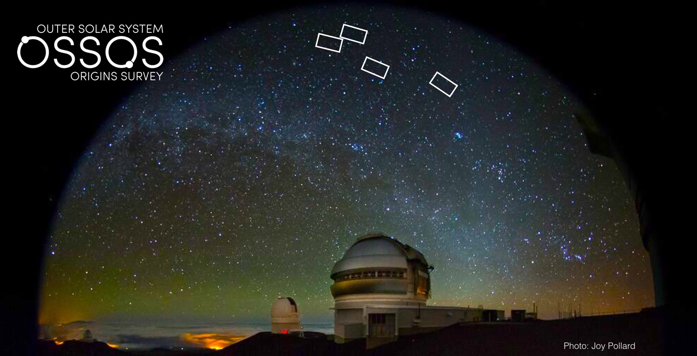
Context
Need to estimate the real TNO population
Old method: simulating fake objects
Problem: not scalable
Need for a ML algorithm
Data from OSSOS
Photo by Joy Pollard found on the sciglow.com website

Slide 4
Data processing
Collect
Prepare
Import
Process
Store
Interpret
1 TB of raw data
Object Oriented Programming
Serialization in JSON format
19 MB of serialized data (without images)

Slide 5
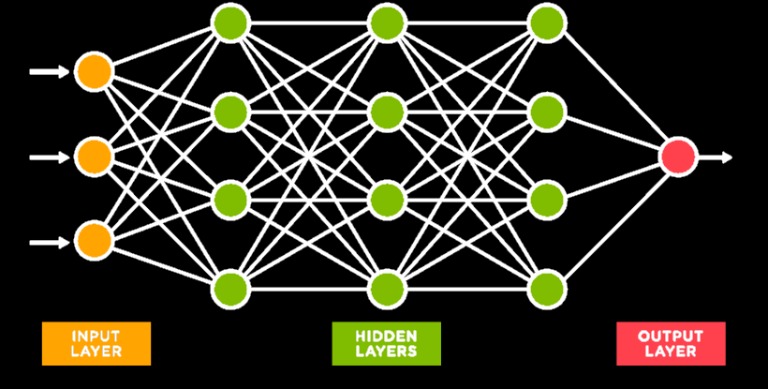

First steps in Machine Learning
Notion of vector $\left(X,Y\right)$
Highly independant of the meaning of the data

Slide 6


First steps in Machine Learning
$Efficiency≈\frac{a}{4}∗\left[1−tanh\left(\frac{m−b}{c}\right)\right]∗\left[1−\tanh\left(\frac{m−b}{d}\right)\right]$
4 parameters
$$\left(\begin{aligned}a \\ b \\ c \\ d\end{aligned}\right)$$

Slide 7

Scaling the data set
10 vectors are not enough to train a neural network
Blocks are composed of statistically redundant data
$\left(\begin{matrix}\begin{aligned}X_{1} \\ X_{2} \\ X_{3} \\ … \\ X_{N−2} \\ X_{N−1} \\ X_{N}\end{aligned} & Y\end{matrix}\right)→ \left(\begin{matrix}\begin{aligned}X_{1} \\ … \\ X_{N−1}\end{aligned} & Y′\end{matrix}\right)+\left(\begin{matrix}\begin{aligned}X_{3} \\ … \\ X_{N−2}\end{aligned} & Y′′\end{matrix}\right)$ + $\left(\begin{matrix}\begin{aligned}X_{2} \\ … \\ X_{N}\end{aligned} & Y′′′\end{matrix}\right)$

Slide 8
Scaling the data set
Accuracy of the resulting model

Slide 9
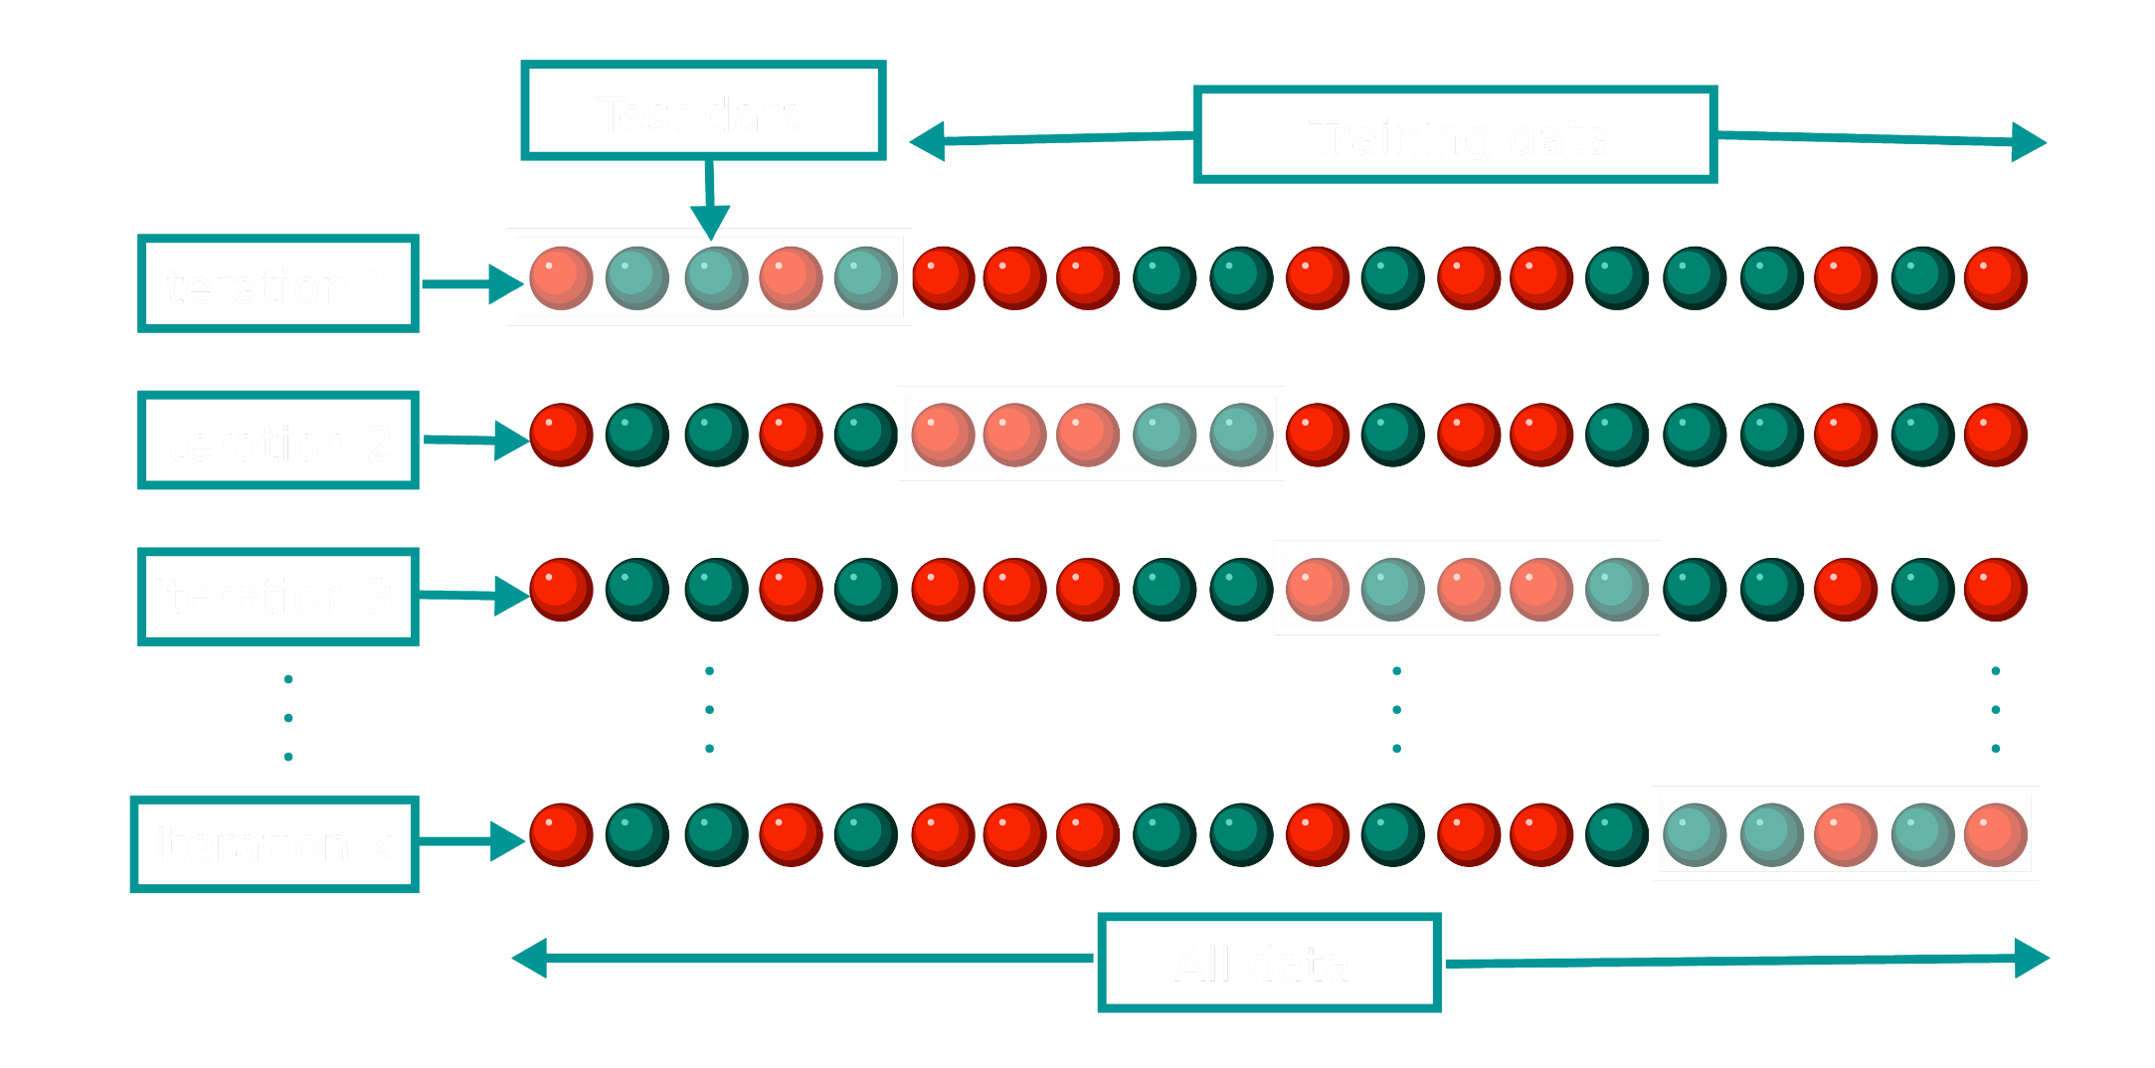
K-fold cross-validation

Slide 10
Genetic algorithm
Train multiple neural networks
Select the best one
Repeat
Evolution of the accuracy over the generations

Slide 11
Fresh news
Some triplet data was available!
Yields larger diversity in outputs
Fast implementation thanks to OOP choice
More promising results!

Slide 12
Fresh news

Slide 13
Conclusion
Promising results
More data -> more accurate network
A lot of parameters and fluctuation in the results
Need to find a way to optimize them

